Slide 1
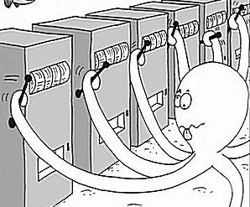
Multi-Armed Bandit
Sanjay Hariharan, Sunith Suresh, Lin Xiao, Ilan Man

Slide 2
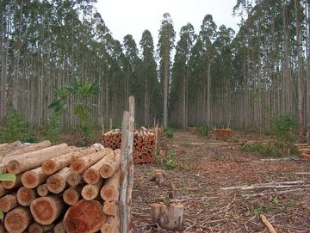

Exploration vs. Exploitation
Exploitation: Capitalizing on information available so far
Exploration: Acquiring New Information
“Bandit problems embody in essential form a conflict evident in all human human action: information verses immediate payoff.”
Notes:
Applications!!
Regret vs. Reward (opportunity cost)

Slide 3

List of Algorithms
Dynamic Programming
Thompson Sampling
𝜺-Greedy
Upper Confidence Bounds (UCB)
AdBandit (pure exploitation)
Gaussian Processes
Many More!

Slide 4
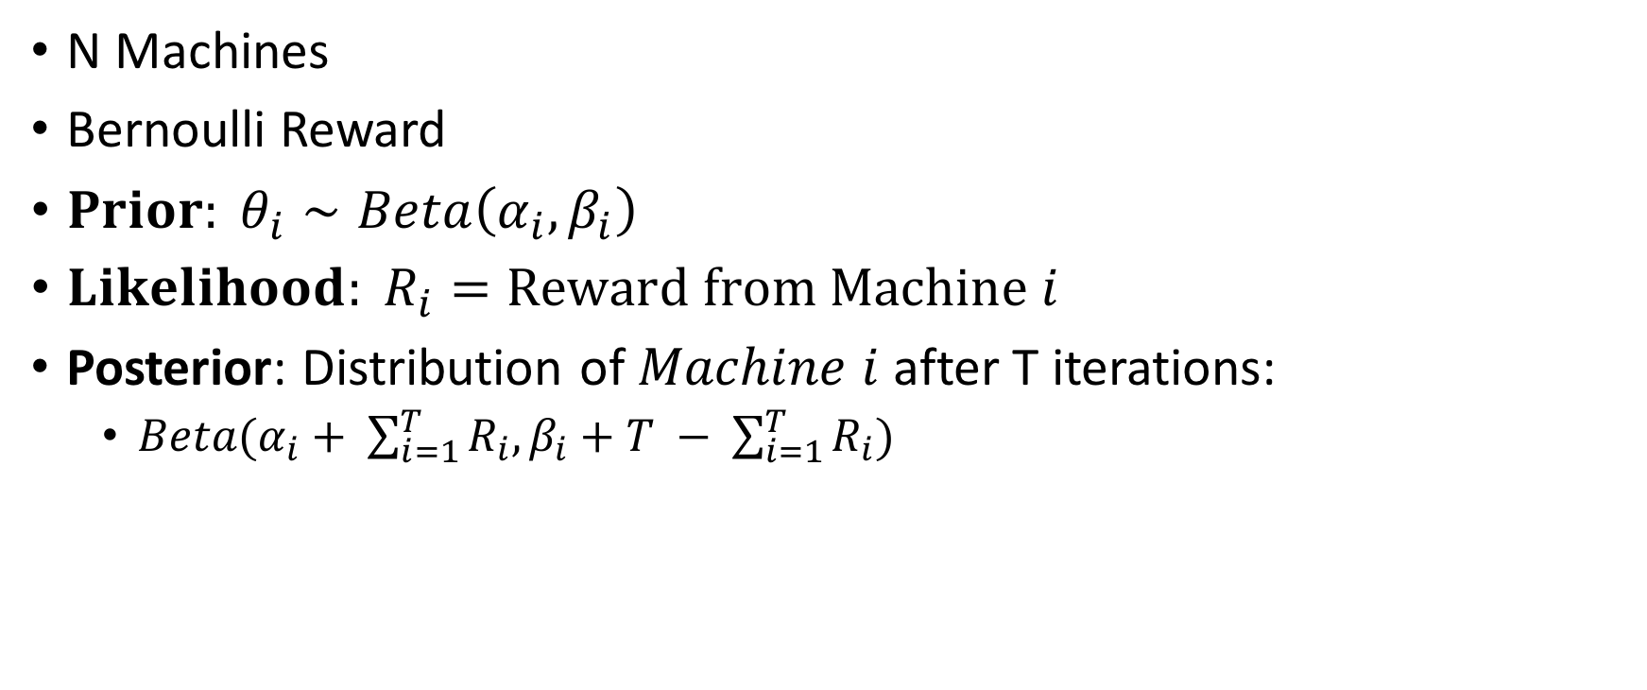
Bernoulli Bandit
😎
😭

Slide 5
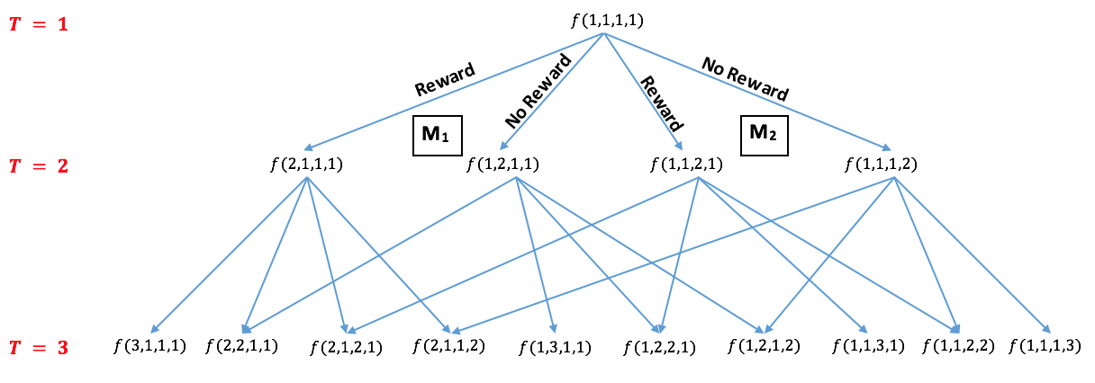
Dynamic Programming
Backwards Algorithm

Slide 6

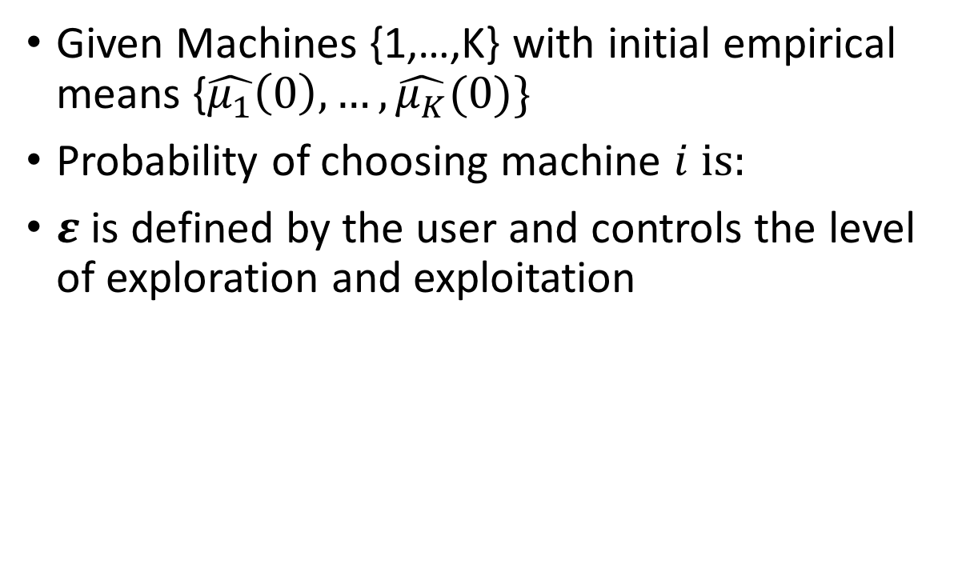
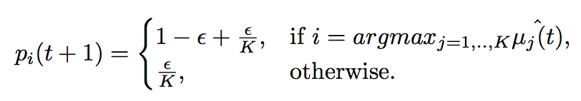
𝜺-Greedy

Slide 7
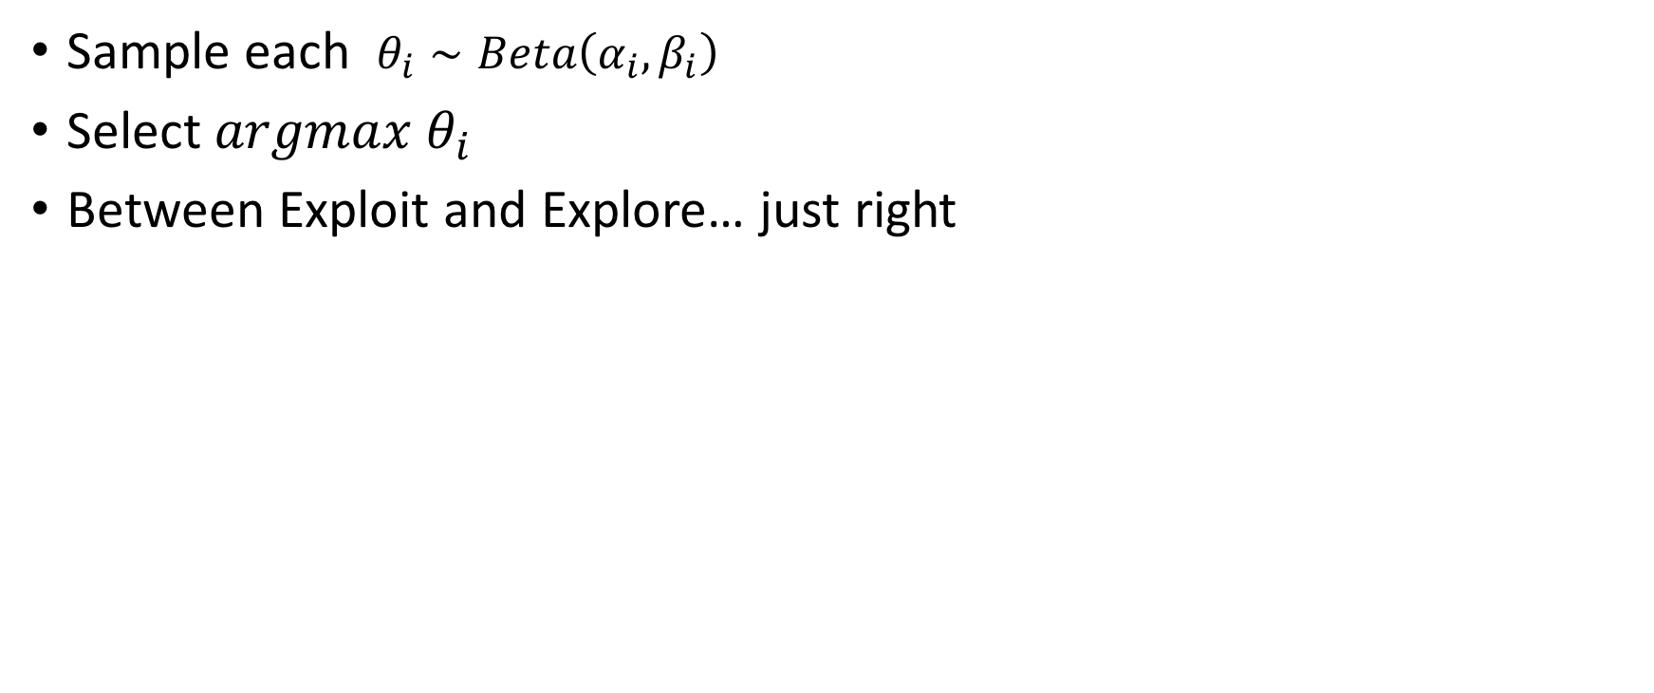

Thompson Sampling

Slide 8
Thompson Sampling

Slide 9
Thompson Sampling

Slide 10
Concentration bounds
sequence of n independent fair coin flips

Slide 11
Concentration bounds
sequence of n independent fair coin flips
let X be the number of heads

Slide 12
Concentration bounds
sequence of n independent fair coin flips
let X be the number of heads
probability of having no more than n/4 heads

Slide 13
Concentration bounds
sequence of n independent fair coin flips
let X be the number of heads
probability of having no more than n/4 heads
# flips to bound deviation from expected value

Slide 14
Concentration bounds
Markov Inequality - use the mean of X
P(X > a) <= E(x)/a

Slide 15
Concentration bounds
Chebyshev Inequality - use the variance of X
P(|X − E(X) | ≥ a ) <= Var(X)/a^2

Slide 16
Concentration bounds
Chebyshev Inequality - use the variance of X
P(|X − n/2 | ≥ n/4 )

Slide 17
Concentration bounds
Chebyshev Inequality - use the variance of X
P(|X − n/2 | ≥ n/4 )
<= Var(X)/ [(n/4)^2]
<= 4/n

Slide 18
Concentration bounds
Chernoff bounds - assume X’s are independent
P(|X − mu | ≥ a*mu)
<= 2e^(-mu*a^2/3)

Slide 19
Concentration bounds
Chernoff bounds - assume X’s are independent
P(|X − n/2 | ≥ n/4 )
<= 2e^(-n/24)

Slide 20
Concentration bounds
Chernoff bounds - assume X’s are independent
EXPONENTIALLY SMALLER PROBABILITY
P(|X − n/2 | ≥ n/4 )
<= 2e^(-n/24)

Slide 21
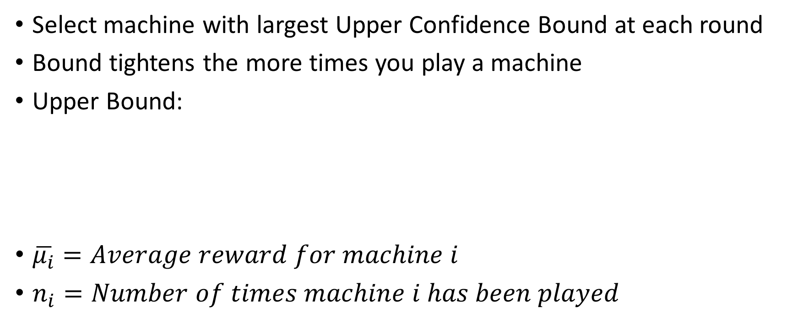

Upper Confidence Bound (UCB)

Slide 22
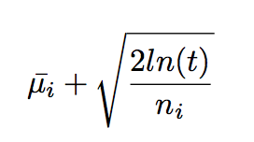
Upper Confidence Bound (UCB)

Slide 23
Upper Confidence Bound (UCB)

Slide 24
Upper Confidence Bound (UCB)
initially ln(t) > n_i...

Slide 25
Upper Confidence Bound (UCB)
initially ln(t) > n_i...
...but soon n_i > ln(t)

Slide 26
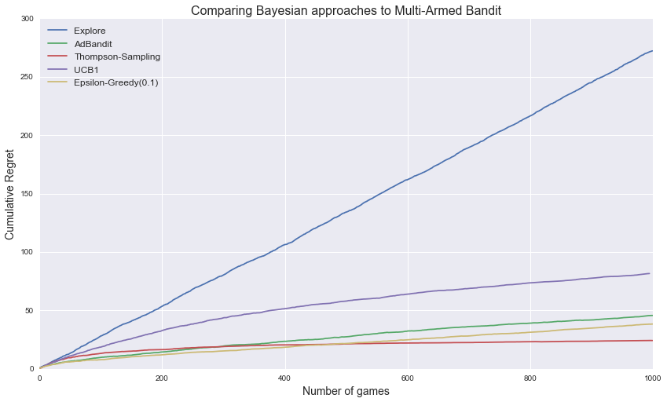

Slide 27
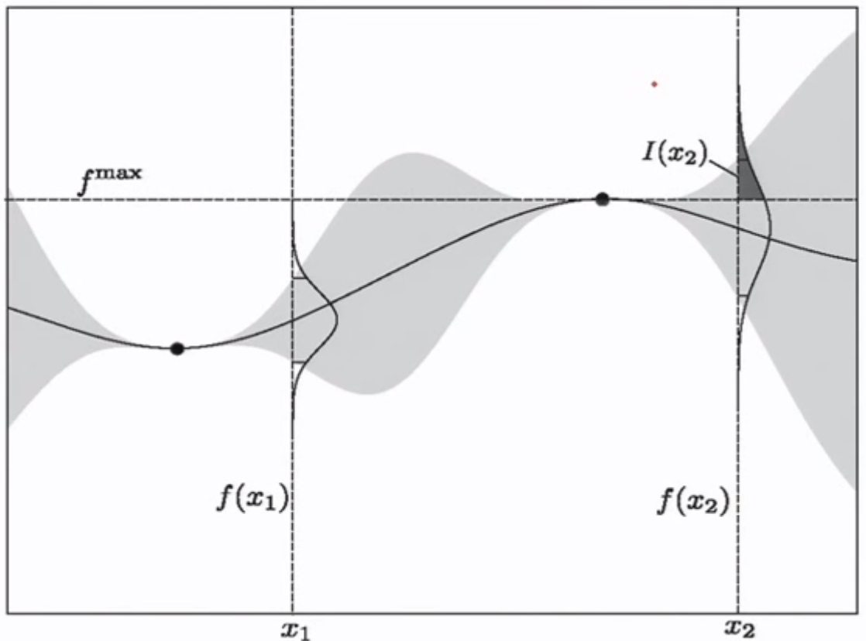
Gaussian Processes
Useful in continuous case!
Probability of Improvement (PI)

Slide 28
GP Fit Over Time

Slide 29
Slide References

